Slide 1





SIH 2020
Govt. of Bihar (DOA)
Project: Develop a Real time land usage monitoring tool using satellite data and AI.
Team : Central Crew
College: Maharaja Surajmal
Institute of Technology, New Delhi

Slide 2
Idea/Solution:-
FarmAid is an application targeted towards the admin officials of Dept. of Agriculture aiming to improve the current condition of Indian farmers by helping them plan their agricultural year. Crop production is mostly influenced by various agricultural as well as climatic factors which can be studied through satellite data made available by ISRO We pre-processed and wrangled the already available data given on the government site: https://aps.dac.gov.in/APY/Public_Report1.aspx where the data in the form of image is converted into NDVI of numeric form.

Slide 3
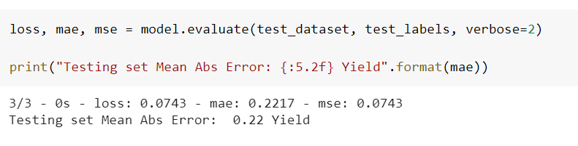
ML
Moving to a Better Model
Arima Model for Time Forecasting and predicting NDVI values for all the months of a Crop-Cycle
Keras Regression Model for Yield Prediction
Scaling 15 Models for each crop-state pair

Slide 4
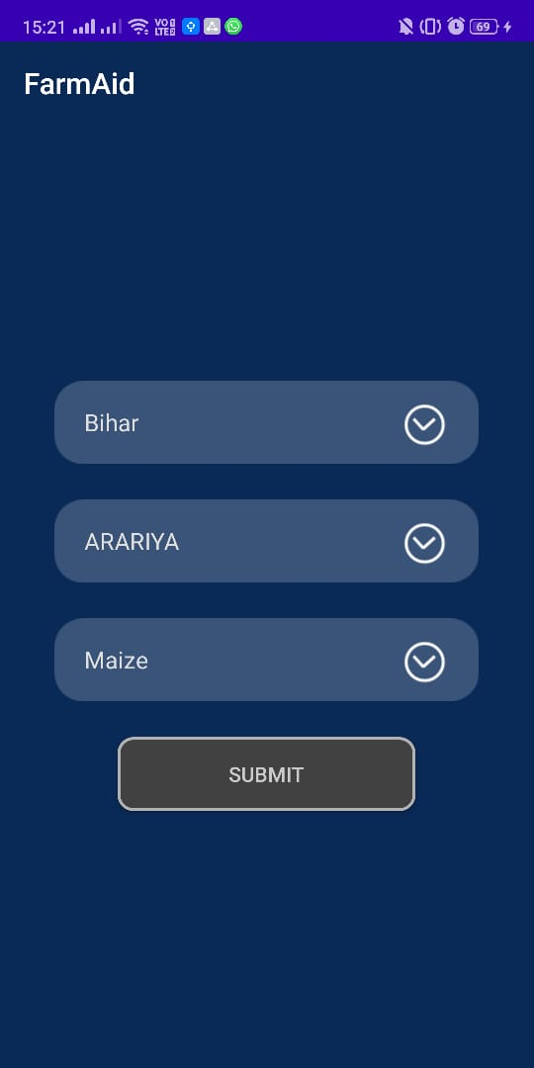
Android
Intro page in which the user gets the option to choose the Specific State, filtering the districts and further the crops.
FarmAid - app for Admin Officials

Slide 5
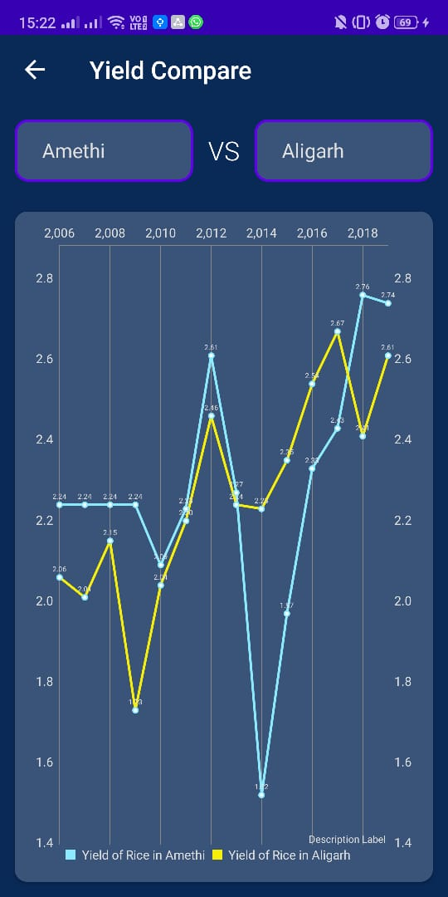
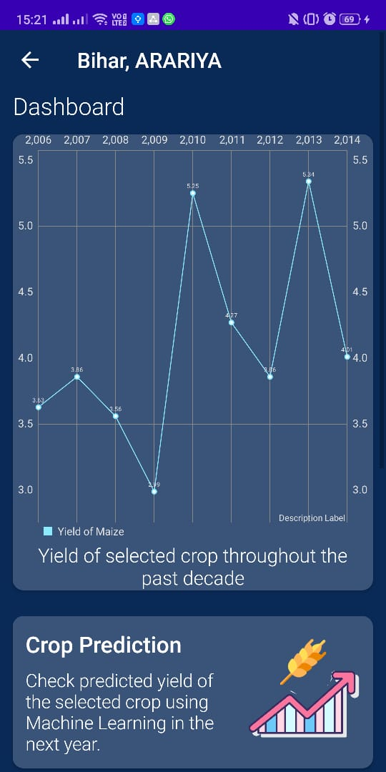
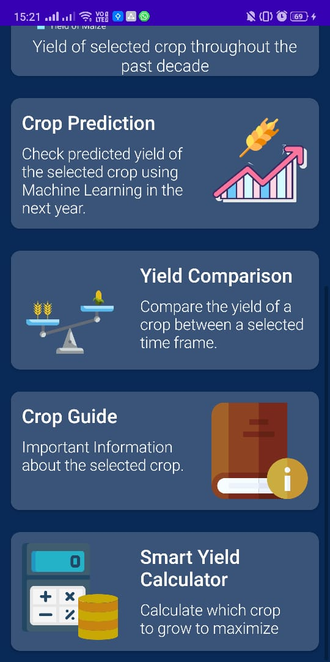
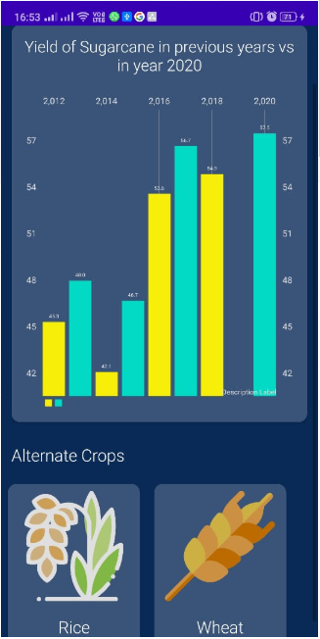
App tour
Android

Slide 6
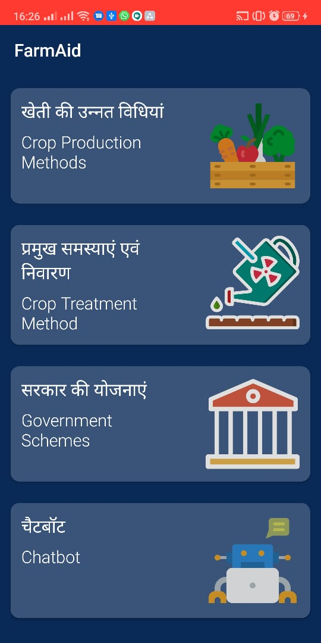
Android
Intro page in which the user gets informational options to choose from in a simplistic manner.
Krishi Sahatya
App for farmers

Slide 7
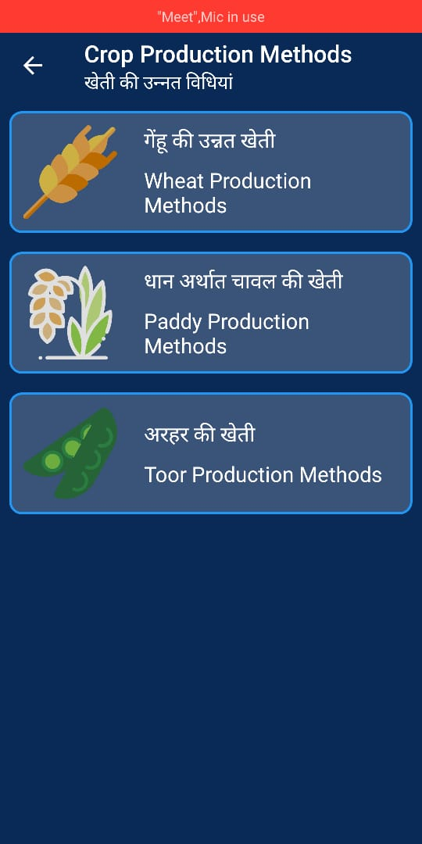
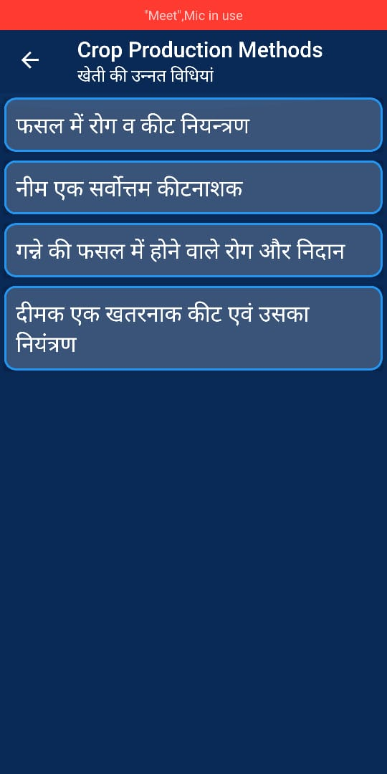
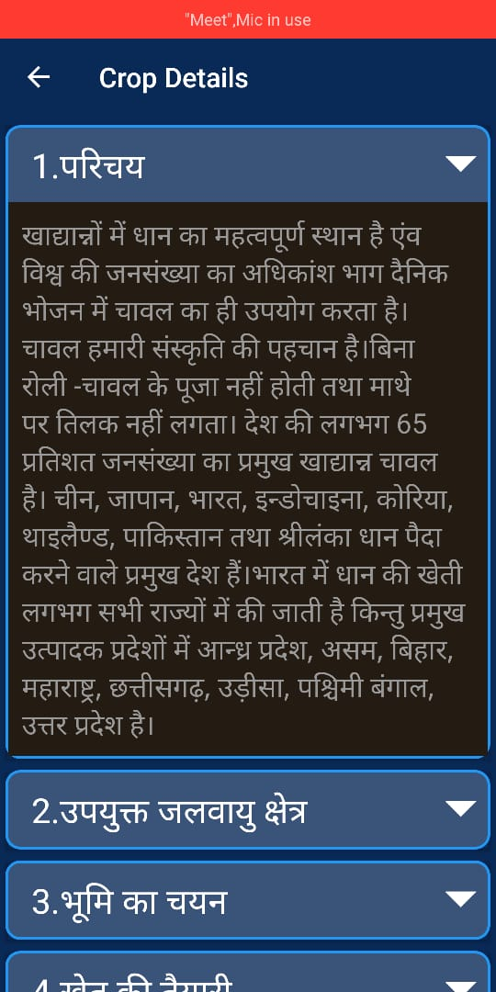
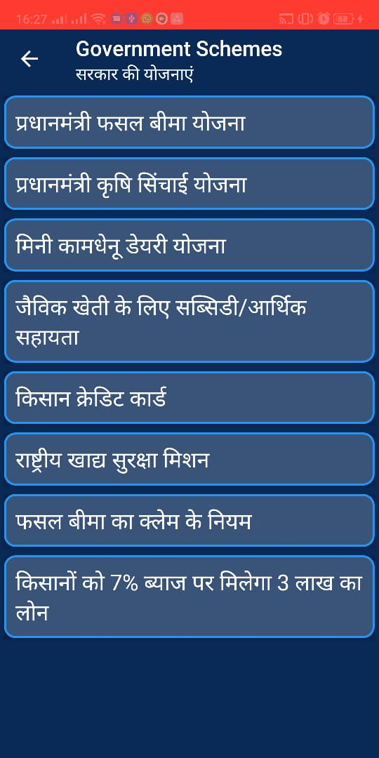
App tour
Android

Slide 8
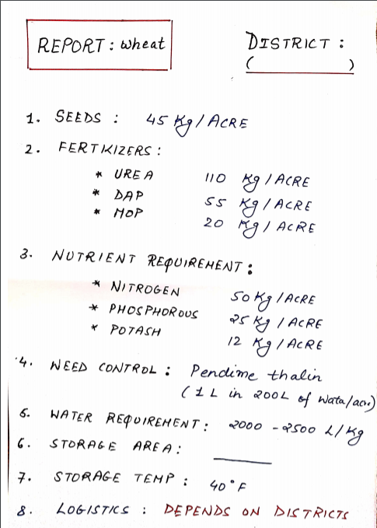
Sample Report
This is the sample form of Report
which we are thinking of adding as
a feature.
User would have the option to download it.
This could increase the scope of application
of our product to the lower management
as well.
This will be in PDF Format and the Data Collection is in progress.

Slide 9
FEATURE | PROGRESS
Solution Appearance - Procurement Report for Govt. Officials Clerical / managerial levels | Data Collection Research .
New Feature: Smart Yield Calculator | Developed. Presentation for tomorrow
User Experience Admin App - Alternate Crops feature | Created simplistic App targeted towards Farmers
Impact - Separate App for Farmers with Simple User Interface | Chat Bot in Progress Rest of the features Developed
Execution - Helpline Numbers for Farmers NGOs Contact Details | Integration in Website

